Slide 1
ML: Student Dropout Rates
By: Esteban Quintanilla, Karina Gonzalez, Adriana Pizana, Mallory Olajide

Slide 2
Proposal/Topic
Earning a college degree is the goal for many students as they think about their futures. Having a college degree in the United States can increase your job marketability, and earn you up to an 86% higher income than those whose highest degree is a high school diploma.* However, not everyone who begins their journey into higher education ends with a degree. In this presentation, we will explore various factors that may contribute to a student dropping out. Hopefully, by understanding what barriers are keeping some students from attaining their goals, we can encourage, support, and promote a learning environment that helps every student to succeed.
*How does a college degree improve graduates’ employment and earnings potential?

Slide 3
Data Sources
The Devastator (Ed.). (2023). Predict students’ dropout and academic success Investigating the Impact of Social and Economic Factors. Retrieved May 28, 2024,.
Link to Kaggle Dataset
Realinho, V.; Machado, J.; Baptista, L.; Martins, M.V. Predicting Student Dropout and Academic Success. Data 2022, 7, 146. https://doi.org/10.3390/data7110146
Link to Study Dataset References

Slide 4
The Process

Slide 5
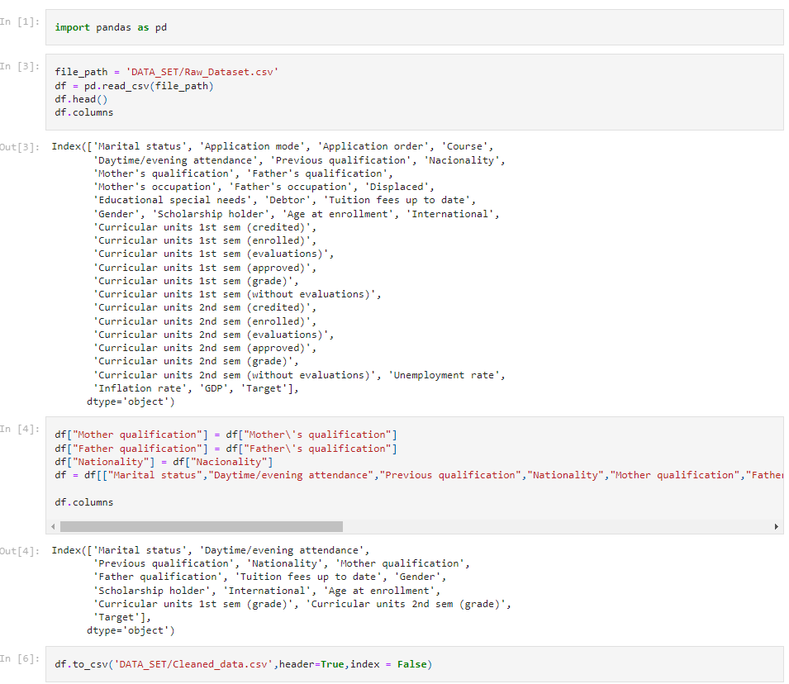
Data Cleaning
When cleaning the data set we omitted a couple of columns that we decided would not be contributing factors towards our determination in predictive models for dropout rates. We also renamed a few columns to fix typing errors.
Notes:
Fixed nationality, made some columns more aesthetically pleasing as well

Slide 6
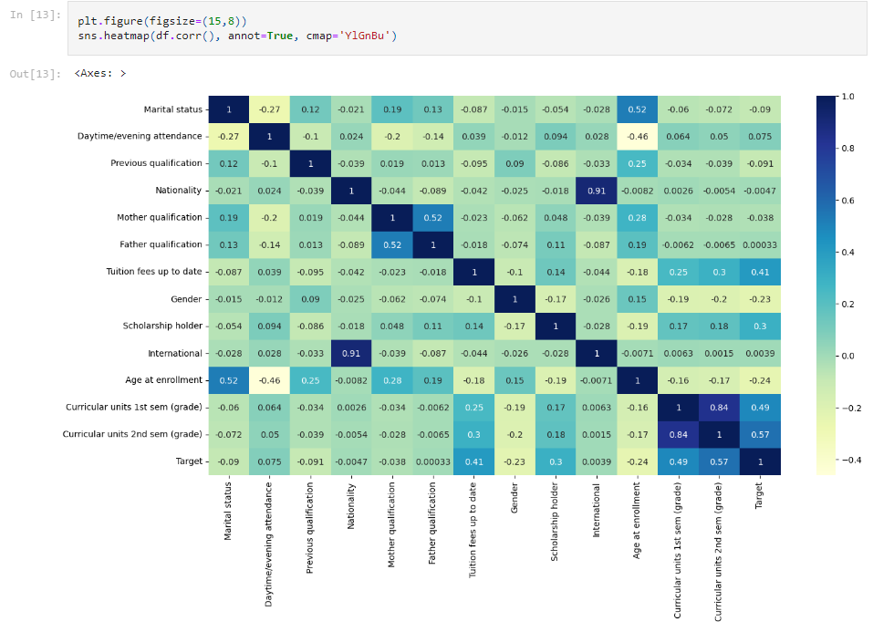
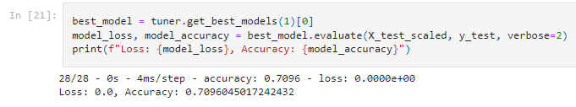
Machine Learning
We utilized the keras tuner to determine the most accurate model and parameters. The six functions used were, “relu”, “tanh”, “sigmoid”, “elu”, “selu”, and “softmax”. The tuner would take about 2 hours to run and would consistently determine that the elu function was the most accurate.
Notes:
Decided to create a correlation heatmap to showcase the related variables. Used hyperparameter choice to pick the best function.

Slide 7
Models and Visualizations

Slide 8
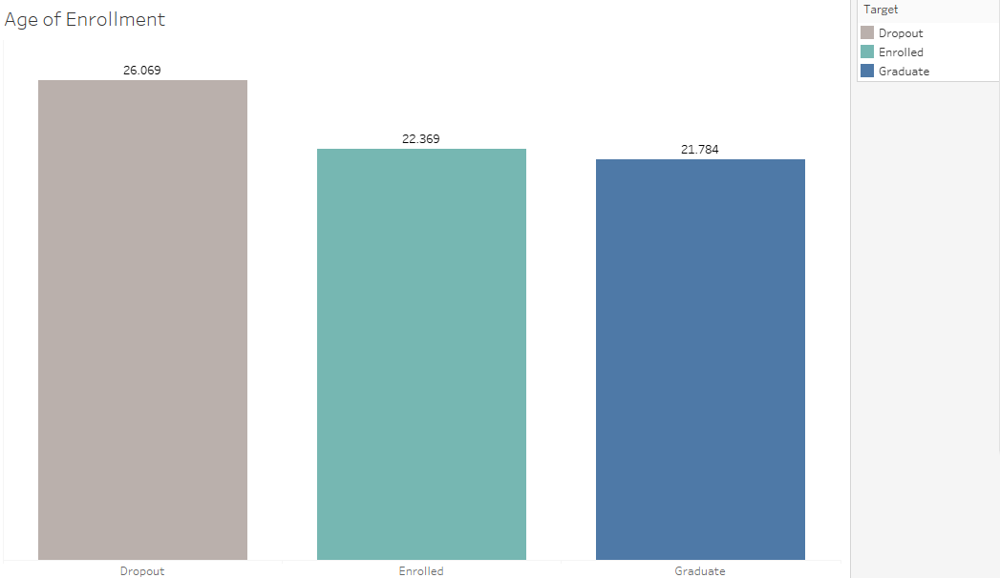
Average Age of Enrollment
Students who enroll at an average age of 26 we can see they are at a higher risk to dropout.

Slide 9
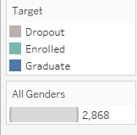
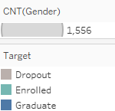
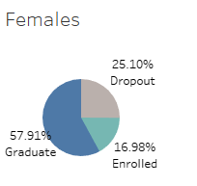
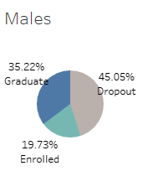
Male vs. Female Students
We considered if gender may play a role in the dropout rate. We noted that on average, men were more likely to drop out than women. This may be an area that warrants further investigation.

Slide 10
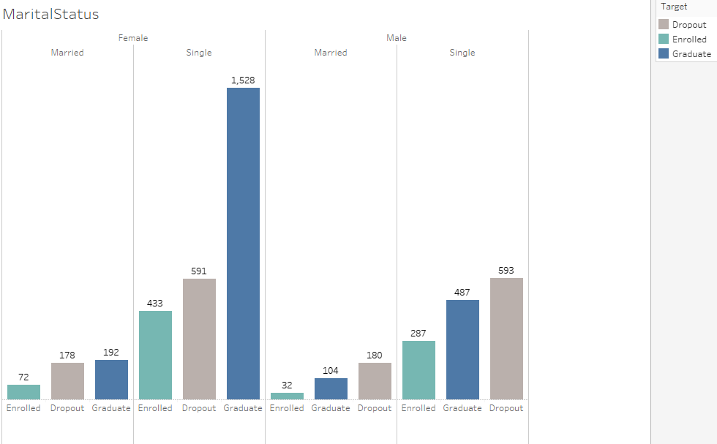
Marital Status
We considered whether marital status impacted the dropout rate. Based on the bar graph created from our dataset we did notice a trend on students, particularly female students, having a higher likelihood of graduating when they were single vs. married. We determined that this may be an area that may warrant further investigation.

Slide 11
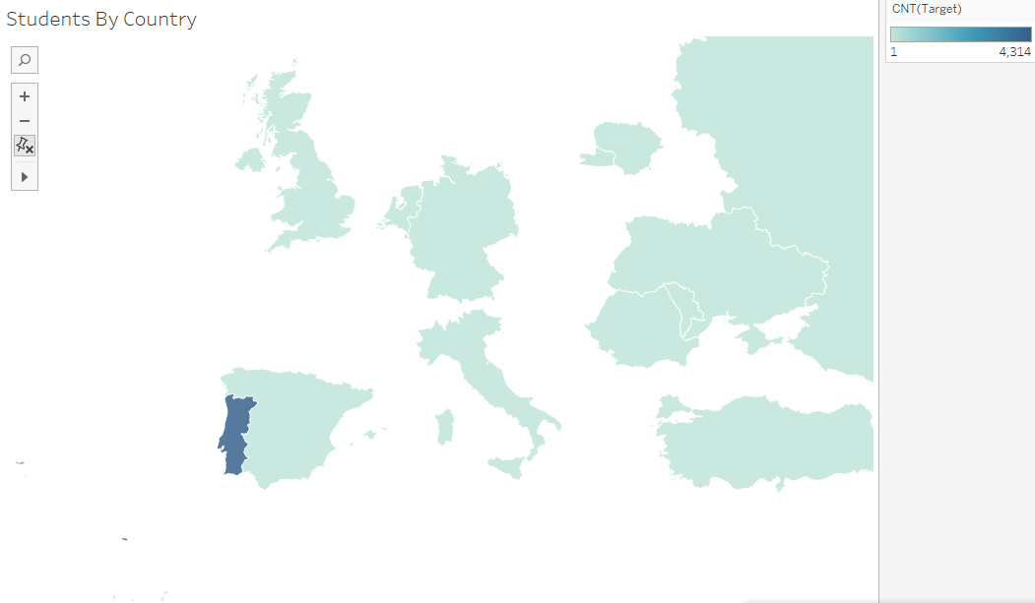
Map of Students by Country
The dataset had different countries identified for students nationality, however; we can see the majority of students were from Portugal.

Slide 12
Analysis of the Process
Separate the features from the target.
Encoded the categorical variables form the features data.
Separate the data into training and testing subsets.
Scale the data using StandardScaler.
Create a method that creates a new Sequential model with Hyperparameter options.
Allow Kerastuner to decide which activation function to use in hidden layers. (relu, tanh, sigmoid, elu, selu, softmax)
Allow kerastuner to decide number of hidden layers and neurons in hidden layers.
Compile the model.
Run the kerastuner search for best hyperparameters.
The best hyperparameter was elu
Accuracy 0.70

Slide 13
Tools Utilized
Python
Pandas
Tableau

Slide 14
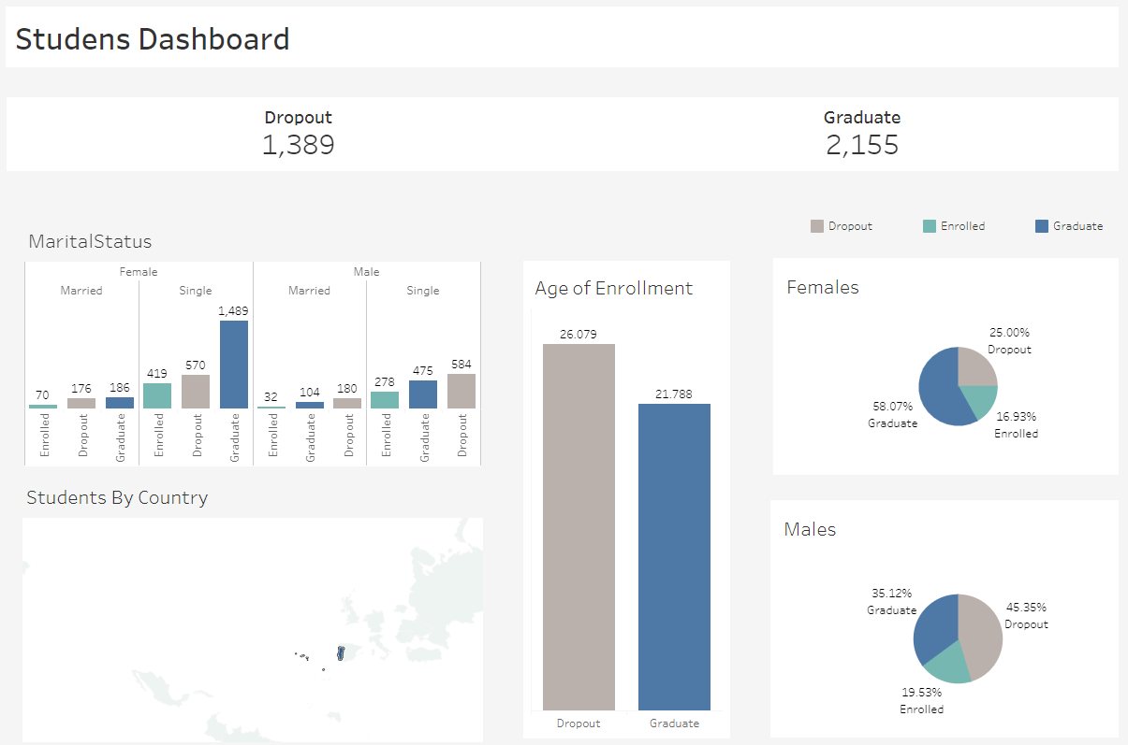
Tableau Dashboard
Follow this link to access Tableau Dashboard

